Slide 1
2050

Slide 2
2050
Population

Slide 3
Main players: USA, China, Europe, India, Japan, Russia, and Brazil.
Caucasians are worldwide minority.

Slide 4
2055:
Global population caps at 9 billion
25% is over 60 years old
“4th world” countries form

Slide 5
Over 2/3 of the population live in urban areas
The tallest skyscrapers reach kilometers in the air and people can spend their whole lives inside these builds without ever going outside

Slide 6
Biology

Slide 7
Genetically-engineered “designer babies” are formed for the rich
Most advanced designs involve manipulating the brain to improve intelligence behavior and personality

Slide 8
Fully synthetic humans are possible
2010: first synthetic cell is created
A variety of specialized organisms follows
More complex life form are created as the decades go by
2056: Number of cells synthesized is almost 100 trillion (the number in the human body)

Slide 9
Natural Resources and Geography

Slide 10
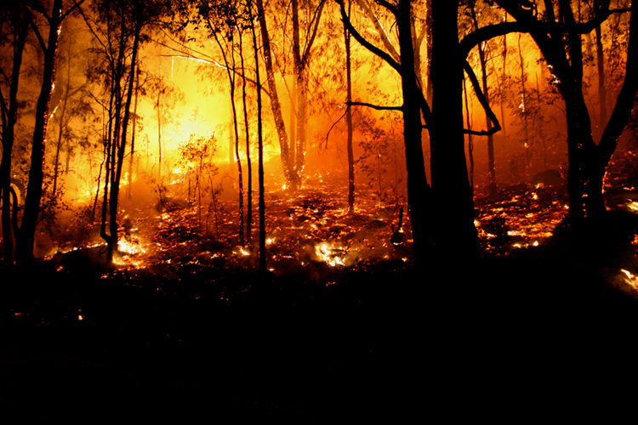
45% of the Amazon rain forest is destroyed
A large amount of biodiversity is lost
Wild fires have tripled in the pacific north west and rocky mountains
2056: Earth is the hottest it has been since the mid-Pliocene over three million years ago
East coast America is devastated
Chesapeake Bay floods
Maryland and Virginia economies suffer
Gold coast region is abandoned
Large migration is underway to Canada
45% of the Amazon Rainforest is destroyed
A large amount of biodiversity is lost
Wild fires have tripled in the Pacific Northwest and Rocky Mountains

Slide 11
Chesapeake Bay floods
2056: Earth is the hottest it has been since the mid-Pliocene era over three million years ago
East coast America is devastated
Maryland and Virginia economies suffer
Gulf Coast region is abandoned
Large migration is underway to Canada

Slide 12
2059:
The end of the oil age
Mars has a permanent presence
Travel to Mars is cheap and fast
Bases constructed underground
In the coming years the first children will be born on Mars

Slide 13
The Arctic became ice-free in 2030 and now has up to 3 months of ice-free conditions per year
Shipping and exploitation of natural resources and trade is popular
Iceland is the new Singapore

Slide 14
Transportation

Slide 15
Space tourism is common
Airplanes use hypersonic engines reducing travel time 2 ½ hours max. world-wide
Seating adjust for maximum possible legroom
Seats morph to fit bodies
Travelers are re-energized with vitamins and anti-oxidant enriched air, mood lighting, aromatherapy and acupressure treatments
http://www.youtube.com/watch?v=uLANvnpvYwM&feature=player_embedded

Slide 16
Cars are controlled by machines and reach speeds over 200 mph
Crashes are rare
Fatalities are virtually nonexistent
Smaller, faster computer-controlled cars are developed

Slide 17
Technology

Slide 18
2052: Hyper-fast crime scene analysis
FBI officers are walking laboratories and the DNA code can be cracked almost instantly
2055: traditional media changes
News no longer exists and is replaced by bloggers, citizen journalists, and bionic eye implants

Slide 19
2053: All desktop PC’s have AI systems equivalent to all of the human brains on Earth combined
Video games provide lifelike simulations with deep levels of interactions
Entire new societies are forming in cyber space
Matrix style worlds are formed

Slide 20
TVs are personalized
Movies have non-linear plotlines allowing the viewer to influence the outcome or even become characters themselves
2057: Computers are so powerful they begin to take over the world
2058: A radio telescope is constructed on the Moon providing images of stars and galaxies billions of light years away

Slide 21
2055
Government

Slide 22
Majority of countries are democratic
The trend begins to plateau in unstable regions such as Africa and Middle East
2056: Pakistan is failed state
Government lost control and armed gangs have power.

