Slide 1
Foundation skills
for Active Reading and Writing

Slide 2
Objective
Students will be able to demonstrate their ability to independently read, evaluate, and comprehend challenging text by thinking visible with active reading strategies, identifying main ideas and elaborations, clarifying information using thinking charts, expanding their vocabulary, and articulating understanding through sentence mastery.

Slide 3
Unit Organizer

Slide 4
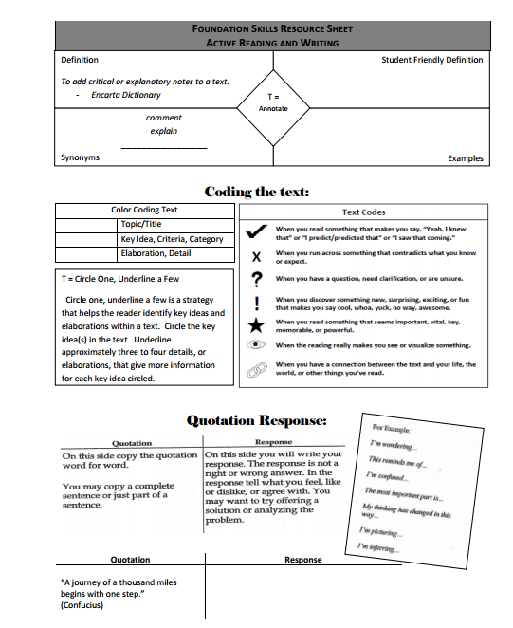
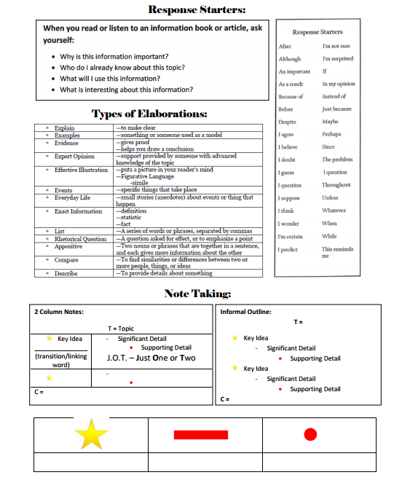
Resource Sheet

Slide 5
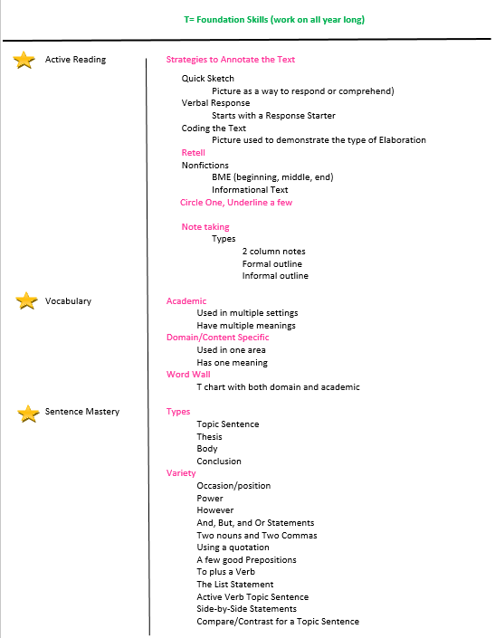

Slide 6
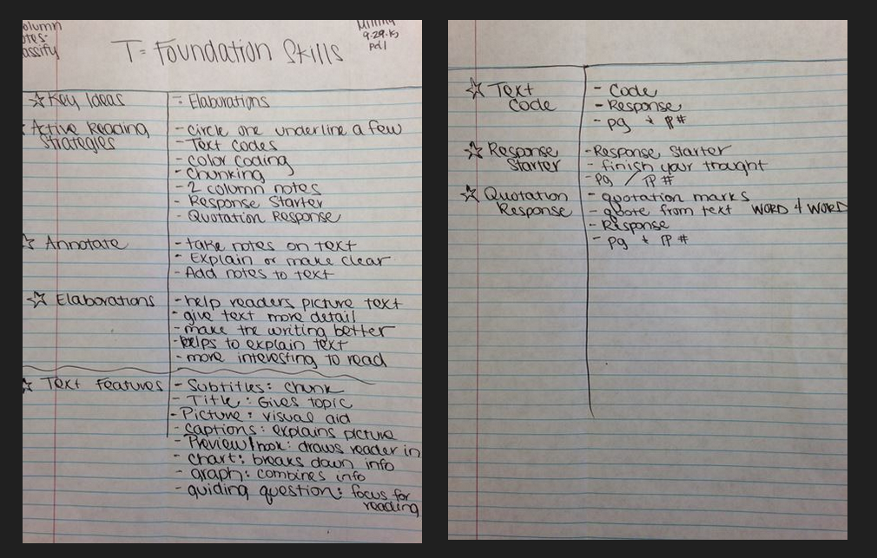

Slide 7
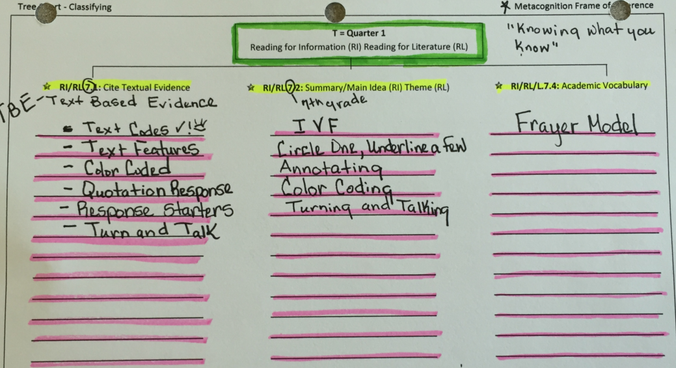
Linking to the Standards

Slide 8
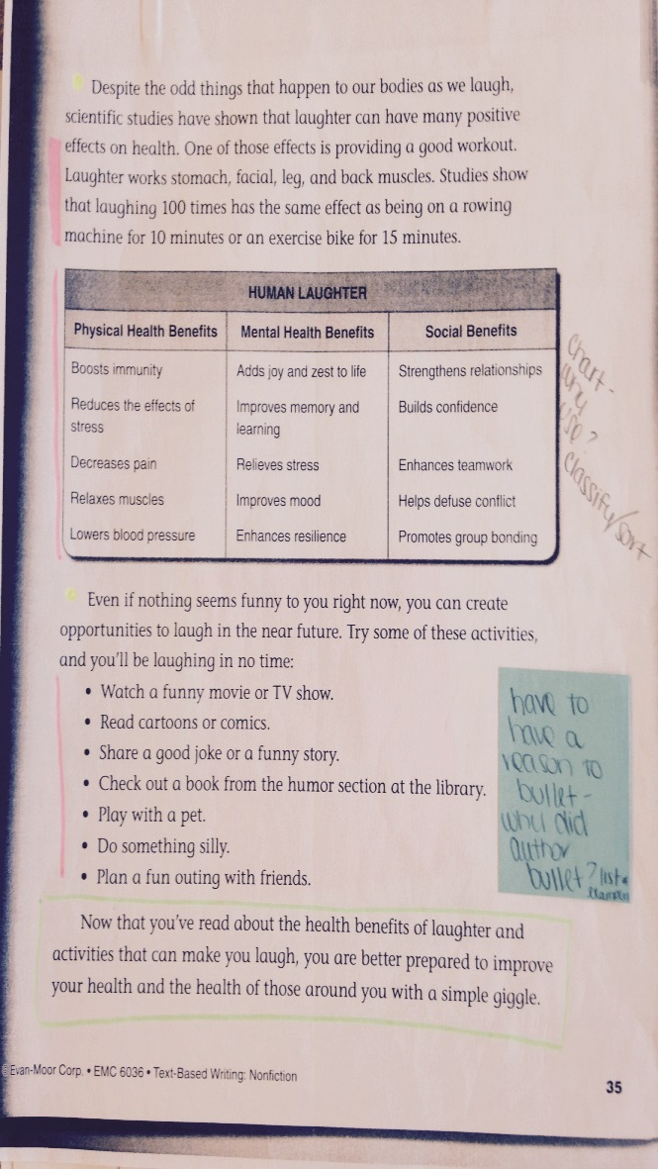
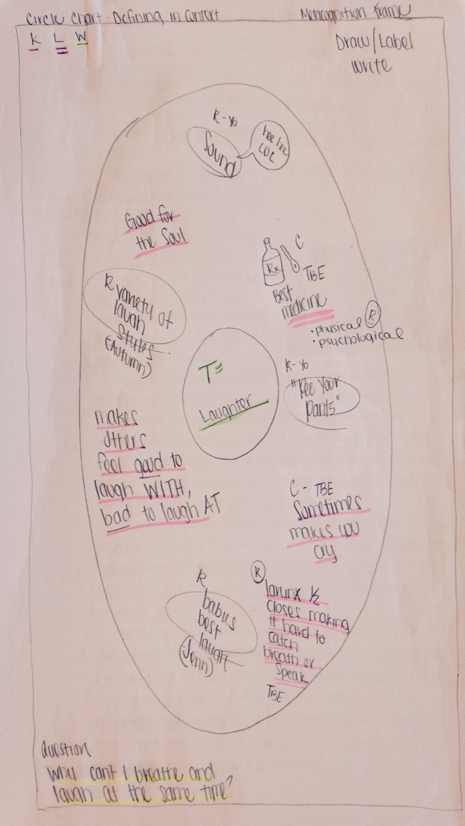
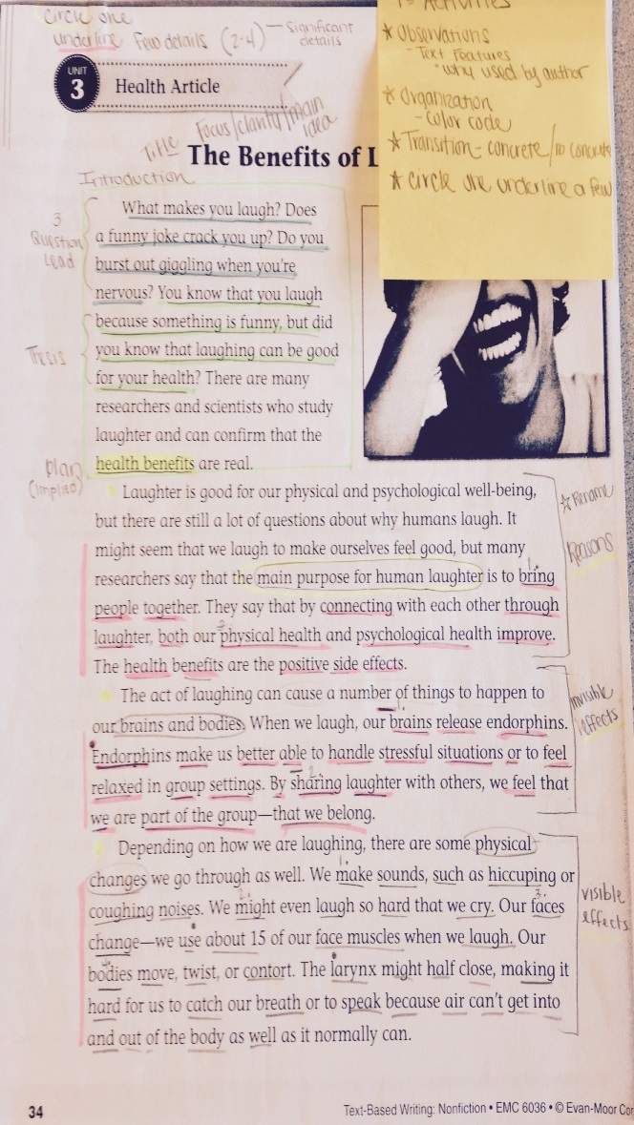
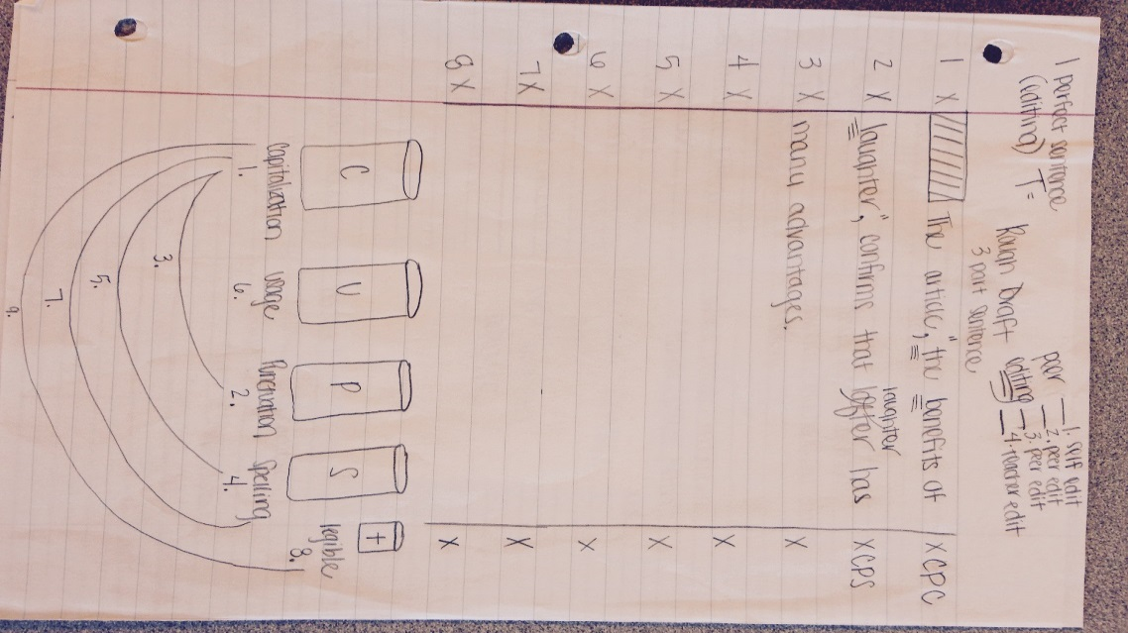
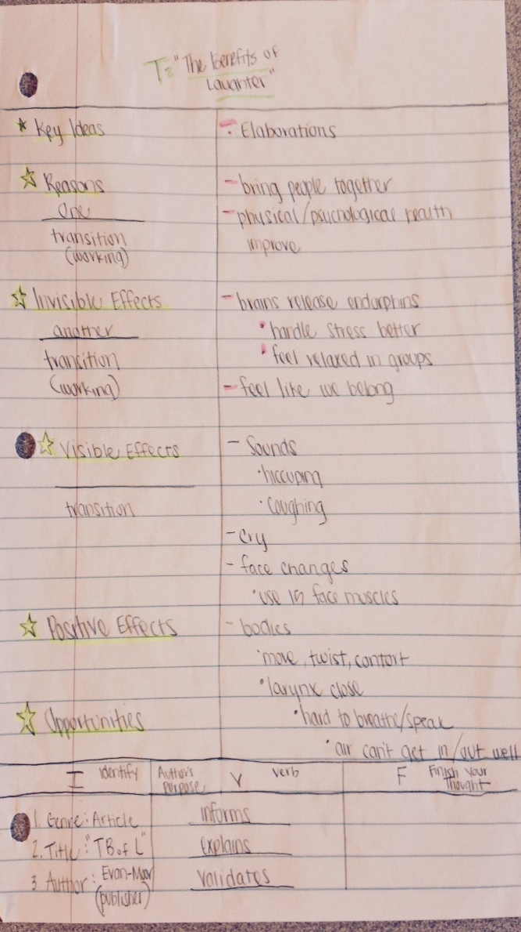
From Active Reading to Writing
Notes:
This slide will show how active reading and writing foundation skills help you progress through the reading and writing progress.
(click) For example, you may start with a thinking chart such as the circle chart to activate prior knowledge on a given topic. (click) Move to a close reading activity where you annotate a mentor text using active reading strategies. (click)
You may revisit and revise their circle charts, adding new information, deleting misunderstandings, and confirming prior understandings. (click)
You can then take your annotations and organize them into a note-taking format, another type of thinking chart such as 2 column notes. By using these strategies, you are also strengthening your understanding of the writing process. (click)
In the past, where most you may have jumped straight from the reading to the writing, this process leads to developing a plan to help organize your writing. (click)

Slide 9
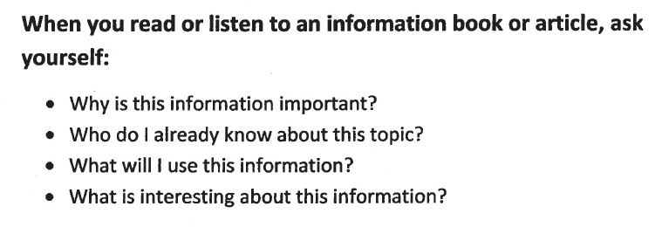
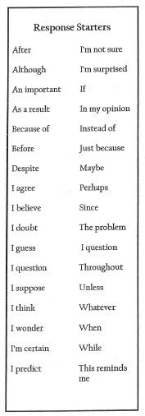
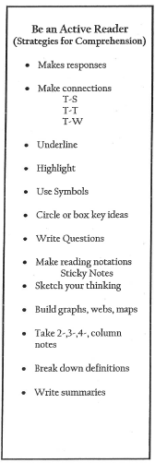
Response Starters
Notes:
Response starters structure your thoughts using key ideas and phrases to have a conversation with the author and think deeply about the text.

Slide 10
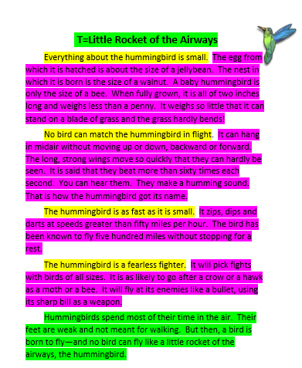
Color Coding
Topic/Introduction
Key Ideas
Elaborations
Conclusion
Notes:
It is important to note that color coding is used to identify all of the pieces of a correctly written text. However, you need to understand not all text follows a pattern and critical thinking is necessary when analyzing a text.

Slide 11
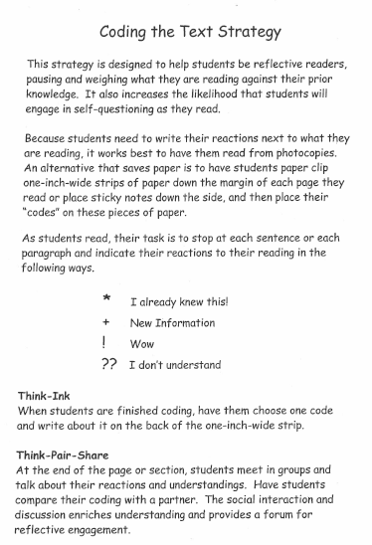

Slide 12
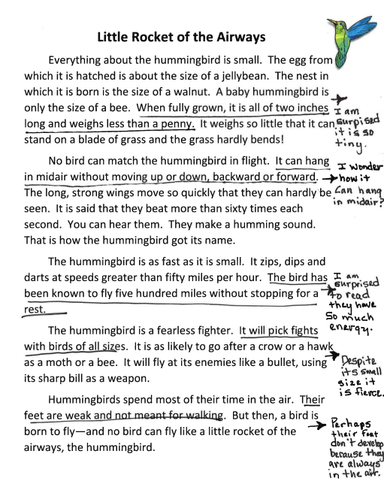
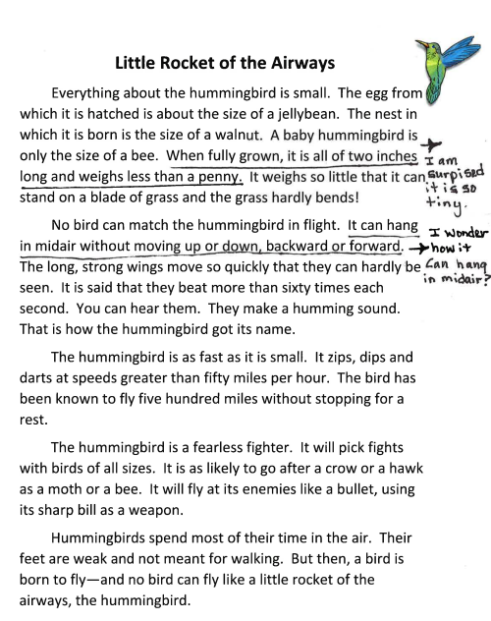
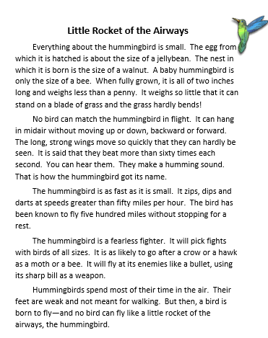
Notes:
After completing a cold read of the text, reread using the response starter strategy. Use a variety of starters to respond to the text. CLICK
The number of responses could be determined by text complexity and purpose for reading. CLICK

Slide 13
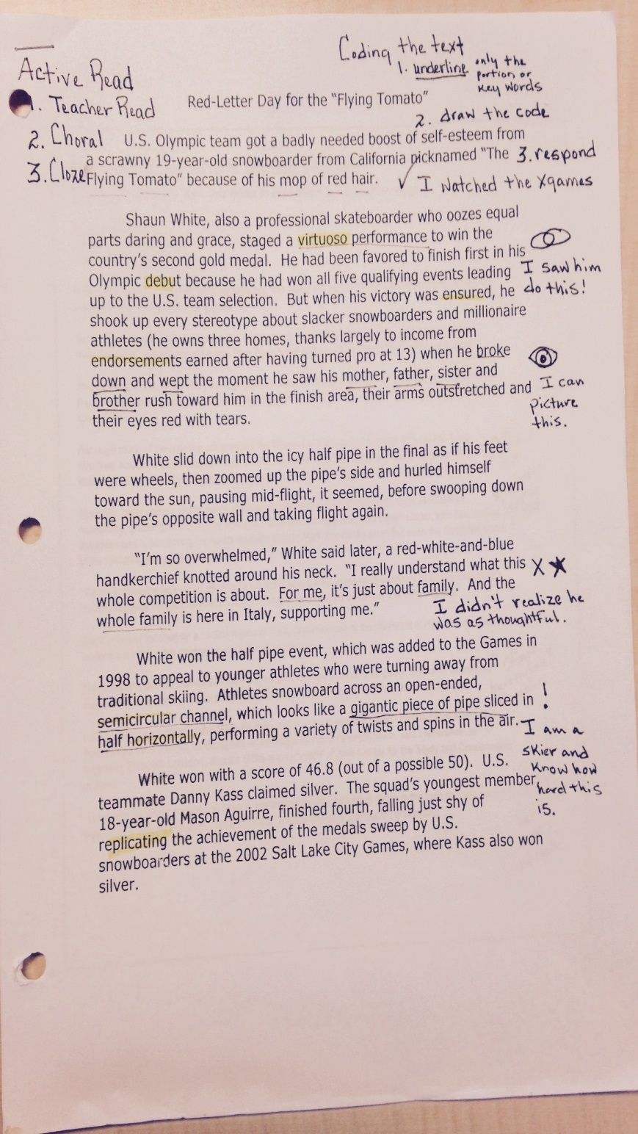
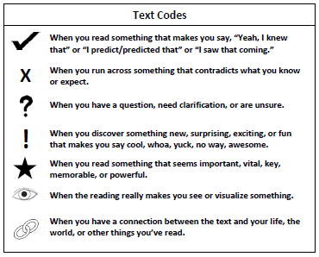
Student Sample:

Slide 14
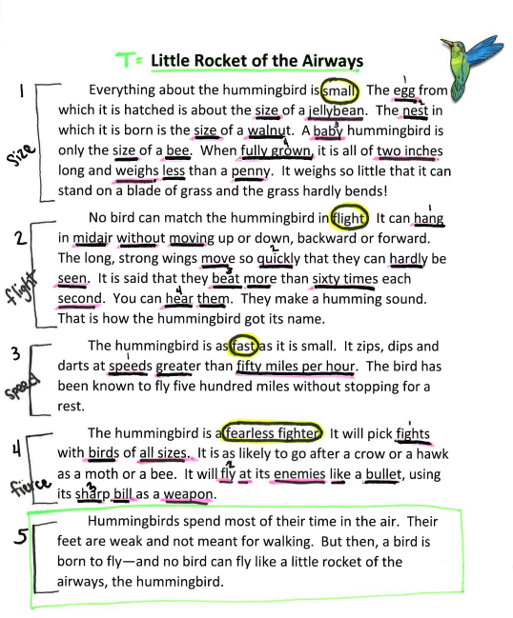
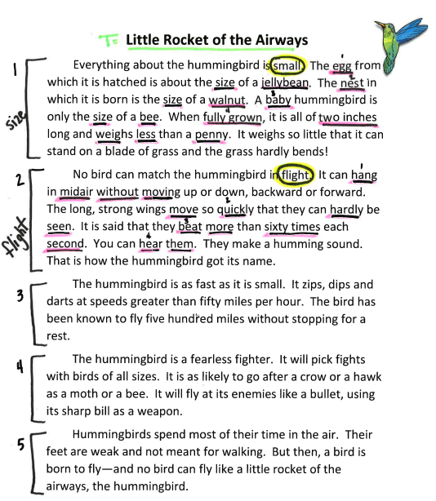
Circle One, Underline a Few
Notes:
To impletement this strategy, you first should utilize the prereading strategy of chunking the text into smaller sections. A good place to start is to chunk a text by paragraphs and number the paragraphs in the text. When reading the chunks, you should rename each chunk created. Renaming reinforces comprehension(summary/or main idea). When you can rename, you know it. Please note, that emphasis should not be placed on one right answer, but on the process of critically thinking about the text. Within each chunk, we identify the key idea about what the author is talking about. This key idea is circled. Each chunk should only have one key idea. The significant details for each key idea are then underlined in the text. CLICK Be sure that only significant details, or details that directly support the key idea are circled. You will be tempted to underline supporting details, or details that directly support the significant details, but this strategy is called underline a FEW, not a lot. Be sure you are thinking critically about the details you underline and that you are limiting yourself to 3-4 details.
Continue to rename the chunks of this article, identify the key ideas in each chunk, and no more than 3-4 significant details for each chunk. CLICK

Slide 15
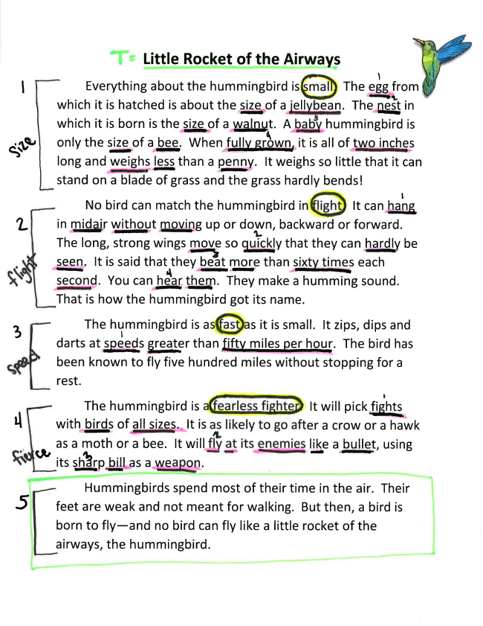
Notes:
The purpose for highlighting a text using the color coding strategy, is not used to identify main idea or differentiate between significant and supporting ideas. The difference between these color coded text examples can be found in the next step:
When revisiting a text for information, you would have to reread the text on the left. Where as on the right, you only have to review the information.

Slide 16
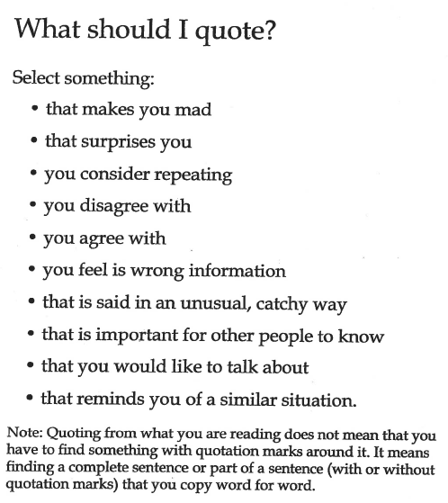
Quotation Response
Notes:
When using this strategy, you should select quotations from the text that generate some response in your mind as you read.

Slide 17
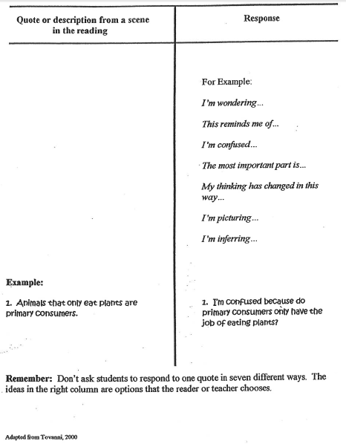
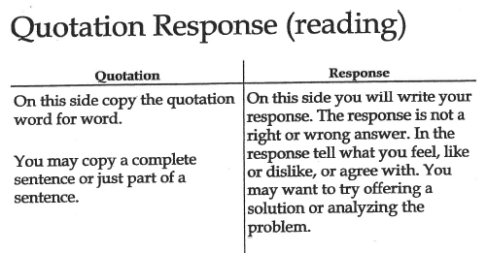
Quotation Response
Notes:
This strategy serves as the starting place for you to use quotations as elaborations in your writing. By quoting an expert and elaborating on that quotation in their own writing, you are demonstrating your ability to cite and elaborate on text evidence in your own writing which is addressing writing standards 1 and 2.
As you watch the Quotation Response Video, determine where the emphasis is placed when using this strategy. Is the importance placed on the quotations students use or their responses to the quotations they selected?
(ADD BRENDA’s Video Here!)

Slide 18
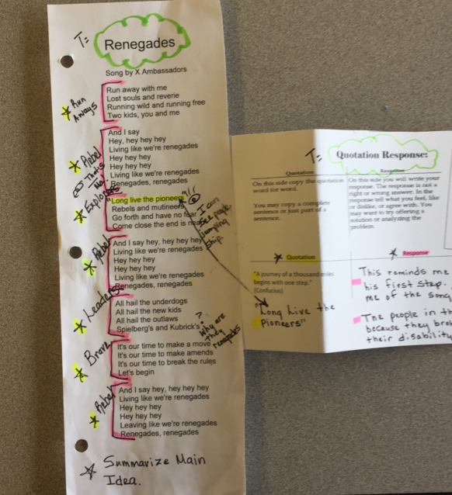

Slide 19
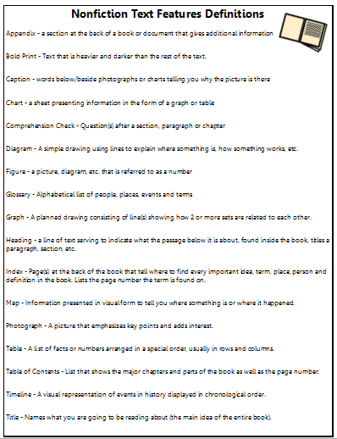
Text Features
Photograph
Title
Notes:
Identifying text features within a text is a great prereading strategy that allows you to gather information about what the text might be about before you read. Identifying the purpose behind the feature, or why the author included the text feature in their text not only encourages higher level thinking processes, but helps you to include text features in your own writing, addressing writing standard 2.
What text features do you see present in this article?
A photograph for example, CLICK, helps the reader to create a picture in their mind about what it is they are reading. Pictures can emphasize key points while adding interest at the same time. CLICK
Titles provide direction to the reader as to what the text will primarily be about. Titles relate to the topic or main idea of the whole text.

Slide 20
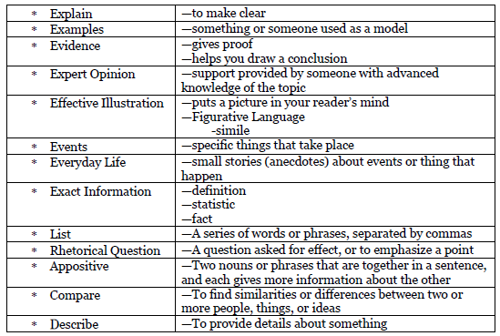
Types of Elaborations
* Cause and Effect | - To note a relationship between actions or events such that one or more are the result of the other or others
Notes:
Elaborations make up the meat of the writing. When you can identify the details in the text, both significant and supporting, you are identifying elaborations. This particular foundation skill is not focusing on whether or not you can identify elaborations, but rather that you can name the elaborations you identified. By naming specific types of elaborations in a text, you show you understand the purpose of the elaboration itself. Understanding the purpose of the types of elaborations is necessary when you need to incorporate elaborations into your own writing, addressing writing standards 1,2, and 3. CLICK
For example, we identified the significant details, “the egg is the about the size of a jellybean, the nest is the size of a walnut, a baby hummingbird is the size of a bee” when we practiced the foundation skill, circle one, underline a few. These elaborations are Compare elaborations. CLICK CLICK CLICK CLICK
The supporting detail, “it weighs so little it can stand on a blade of grass and the grass hardly bends” can be considered an Explain elaboration CLICK, further explaining the weight of the bird, thereby making that significant detail clear. CLICK CLICK CLICK
What could you call the significant and supporting details, “you can hear them. They make a humming sound”? CLICK Maybe you said Exact Information, as this elaboration provides facts for what sound the birds’ wings make. It is important to emphasize that naming the type of elaborations isn’t necessarily a “one right answer only” strategy, but more of a “best fit” strategy. The emphasis should be placed on the critical thinking through processes students utilize when determining which type of elaboration best fits the elaboration as it is being used in the text. CLICK CLICK CLICK
Which type of elaboration best fits the fact that the birds dart at speeds greater than 50 miles per hour? CLICK The best fit here would be Exact Information. CLICK CLICK CLICK
How would you label the elaboration “it will fly at its enemies like a bullet, using its sharp bill as a weapon.” CLICK
This is a great use of similes in writing, a form of figurative langauge that helps to create an effective illustration in the reader’s mind. CLICK CLICK CLICK
What type of elaboration is “no bird can fly like a little rocket of the airways, the hummingbird.” CLICK
This elaboration is an appositive, two nouns side by side, each giving more information about the other. CLICK CLICK

Slide 21
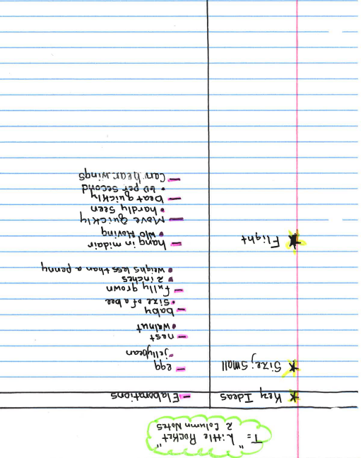
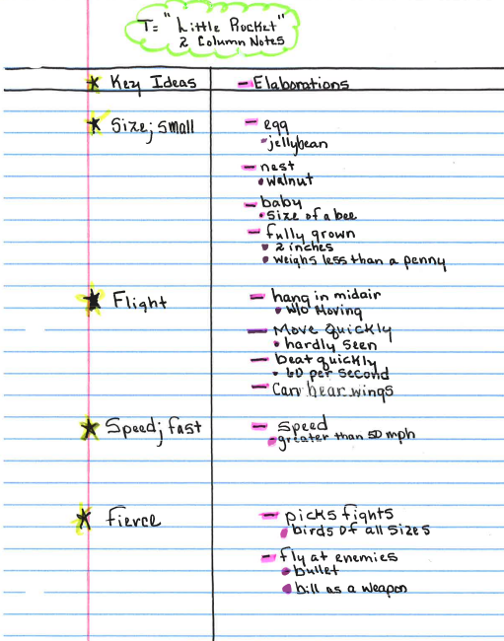
2 Column Notes
Notes:
When transferring annotations from the text to 2 column notes, key ideas are recorded in the left column. CLICK CLICK Elaborations are recorded on the right. Significant details, remember these are the details that directly support the key idea in the chunk, are recorded as dashes. Supporting details, the details that give more information on the significant details, are recorded as dots. CLICK CLICK CLICK

Slide 22
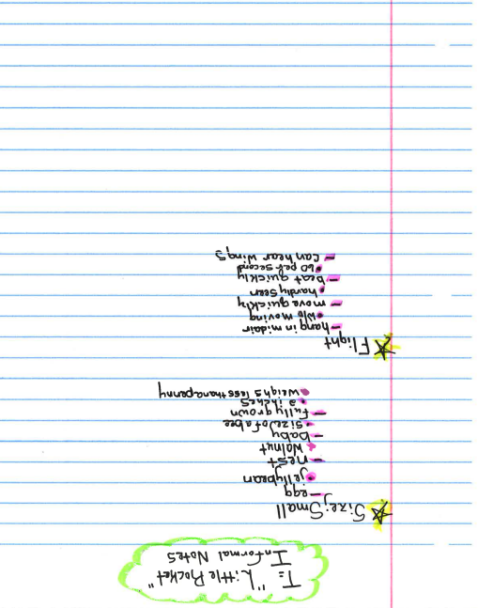
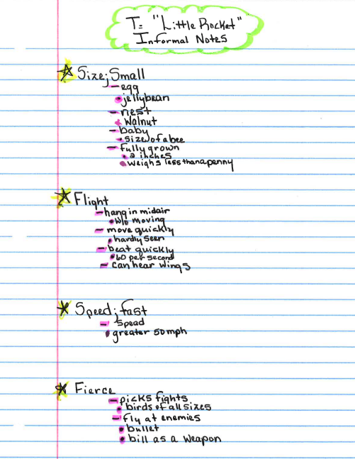
Informal Outline
Notes:
The process for transferring annotations in a text over to the informal outline mirrors the same process as transferring annotations over to 2 column notes. Rather than recording the key ideas and elaborations into different columns, however, annotations are transferred over and written right down the left side of the page. Key ideas are placed alongside the margin. CLICK CLICK Significant details are recorded as dashes and are underneath the key ideas and are indented. Supporting details are recorded as dots and are below the significant details, and indented in as well. CLICK CLICK CLICK

Slide 23
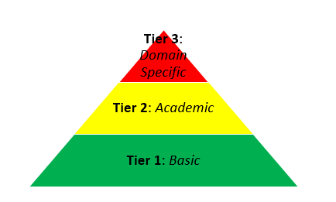
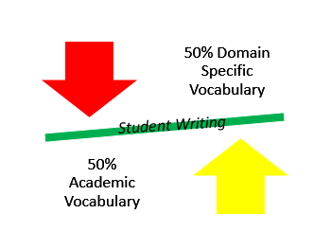
Academic vs Domain Specific
novel
meal
utensil
prose
cuisine
apparatus
book
food
tool
Notes:
The broad range of diverse vocabulary words can be classified on a tiered basis. Your writing needs to reflect a 50/50 combination of academic and domain specific or tier 2 and tier 3 vocabulary words, addressing langauge standard 6.
Tier 1 vocabulary words are the most basic of vocabulary words and are the most commonly used. CLICK These words include low level words such as tool, food, and book. CLICK
Tier 2 vocabulary words are academic vocabulary words. These words are less common than the tier 1 words, and have multiple meanings. These words can be seen in multiple content areas with a variation of meaning in each area. In other words, the meaning of the word is dependent on the use of the word. CLICK A tier 1 vocabulary word such as tool, however, when increasing the tier level can become utensil, food becomes meal, and book becomes novel. CLICK
Tier 3 words are the least common vocabulary words. These words are domain specific, meaning they have only 1 meaning and are used in only one domain. CLICK For instance, when increasing the teir level from tier 2 to tier 3, utensil becomes apparatus, meal becomes cuisine, and novel becomes prose. The importance in determining the tier level of the vocabulary word in question should be placed on the thought processes you go through, rather than on one right answer. Determining whether a word is academic or domain specific should lead to a discussion about the use of the word, and emphasis should be placed on the discussion itself rather than on one right answer. CLICK

Slide 24
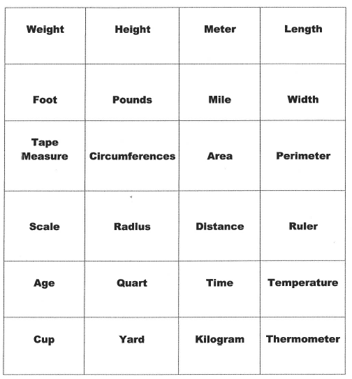
Word Sort
Place the following words under the appropriate Tier:
Tier 2: Academic Vocabulary |  |  | Tier 3: Domain Specific Vocabulary
Height
Meter
Length
Foot
Pounds
Mile
Area
Perimeter
Scale
Radius
Distance
Width
Tape measure
Circumference
Quart
Kilogram
Thermometer
Age
Time
Temperature
Cup
Yard
Ruler
Notes:
When looking at the word bank on the left, some words may stand out to you that have multiple meanings. The words that appear in multiple domains and have more than one meaning are tier 2 vocabulary words. CLICK These are words such as height, meter, length and foot. Can you see any other tier 2 vocabulary words? CLICK Did you identify age time temperature cup yard and ruler as tier 2 words?
What are some of the tier 3 words you identiftied? CLICK These words are width, tape measure, circumference, quart, kilogram, and thermometer.

Slide 25
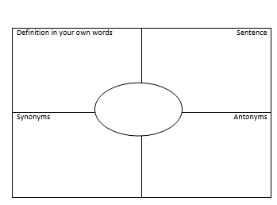
Defining Vocabulary – Frayer Model

Slide 26
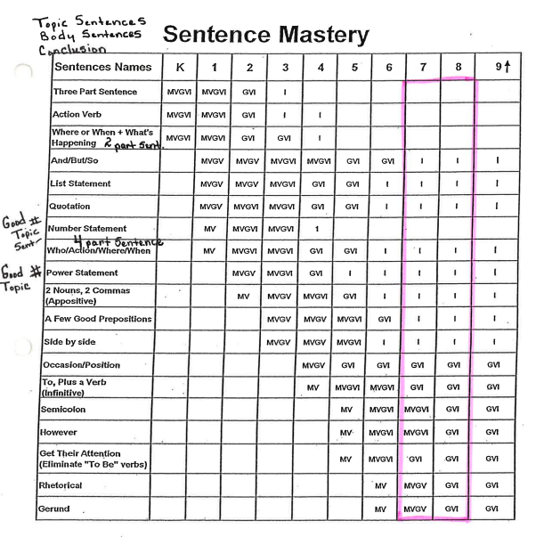
Topic/Thesis Body/Conclusion
Notes:
Sentence Mastery speaks specifically to language standard 1, where you should choose among compound, complex, and compound-complex sentences in their writing. Because there are so many different sentence types for you to master in order to utilize in your writing, Sentence Mastery is a gradual exposure to the different sentence types and a gradual release of ownership once sentences have been mastered. This chart illustrates at what point in your educational career you are exposed to each sentence type, and the gradual release of ownership is illustrated as the grade levels increase. The sentences listed in this chart would enrich your writing when used as topic, thesis, body, or conclusion sentences.

Slide 27
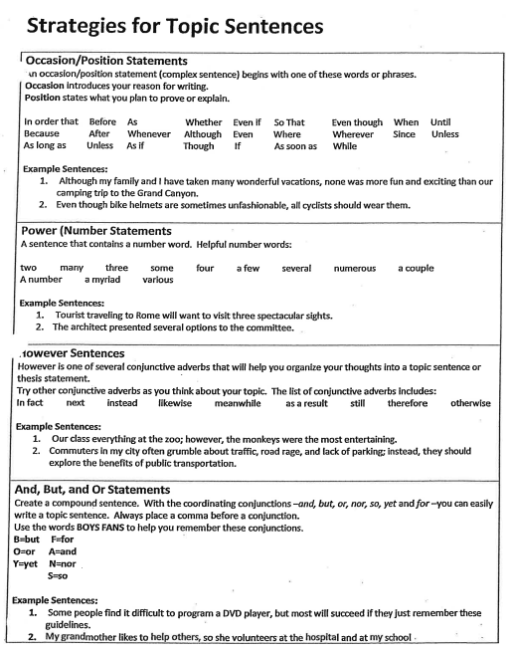
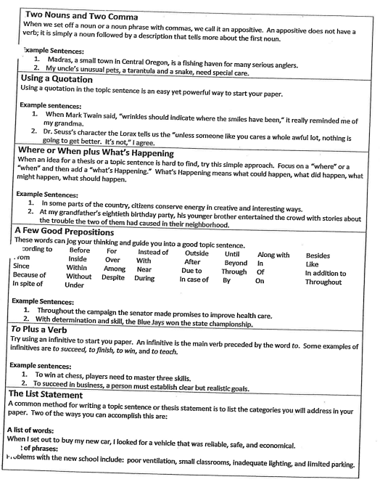
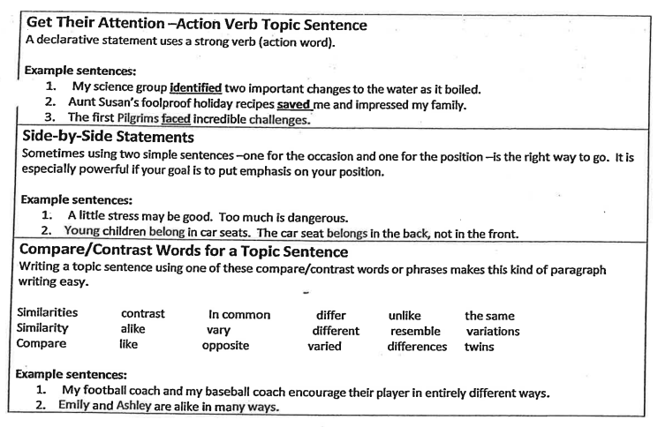
Examples

Slide 28
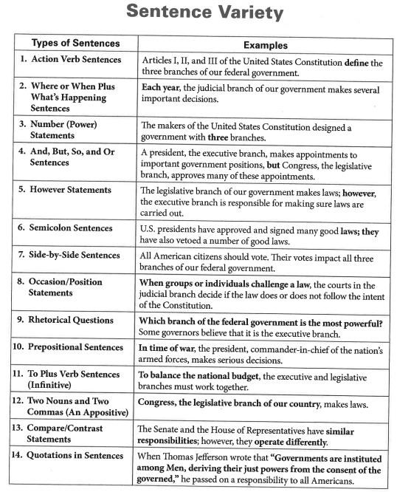
Variety
Notes:
Including a variety of different types of sentences is a way for you to enrich your writing.

Slide 29
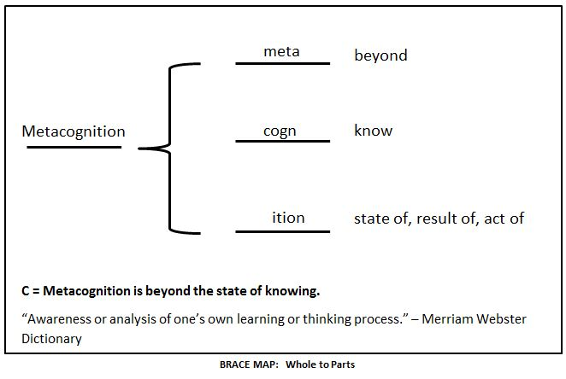
Notes:
The concept of thinking charts is a critical foundational skill that not only organizes your thinking about a particular topic but hones critical thinking thought processes by attaching specific skills to various charts. Thinking charts also reinforce your metacognitive skill of thinking about your thinking by requiring you to give thought to how you know what you know about a topic.
This thinking chart is an example of a brace chart, a great tool to analyze whole to part relationships.

Slide 30
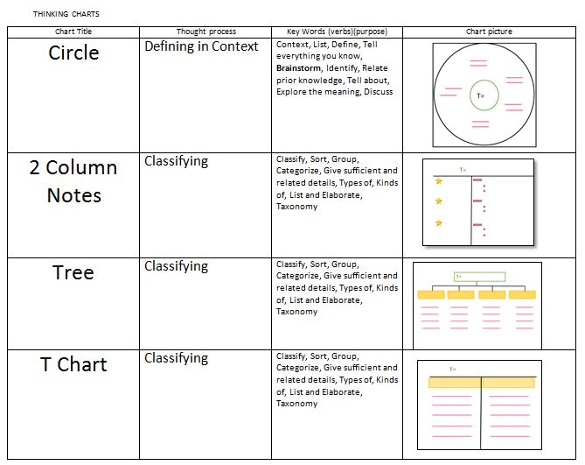
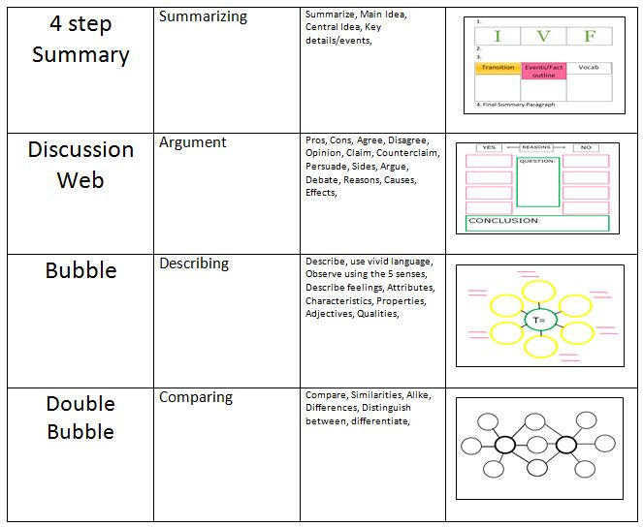
Variety
Notes:
When you are consistently attaching a specific skill to each chart you use, you will begin to take ownership of the thinking charts. The goal is to have you first be able to identify the critical thinking skill involved in their task, and know which thinking chart will help you organize your thoughts.
CLICK When thinking charts are owned by the you, teachers no longer have to ask you to use a particular chart, or even guide you in creating the chart itself. You will begin to independently create and use thinking charts for your particular purpose.

Slide 31
Circle Chart
Notes:
The circle chart is a good alternative to the strategy of KWL. Regardless of the type of writing, circle charts can be used to generate ideas about any topic.

